Slide 1

ECE-2002 Computer Organization and Architecture
Dr. Kritika Bansal
School of Electronics Engineering, VIT-AP

Slide 2
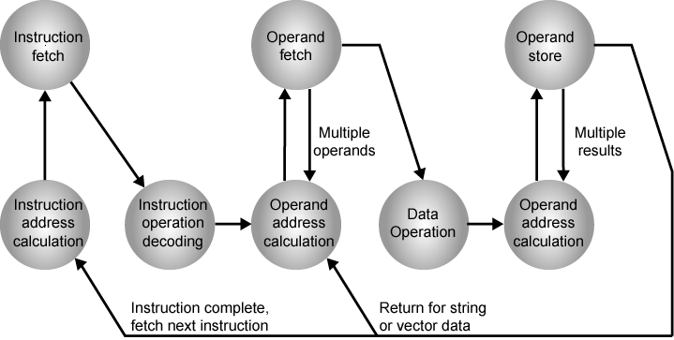
Instruction Cycle State Diagram

Slide 3
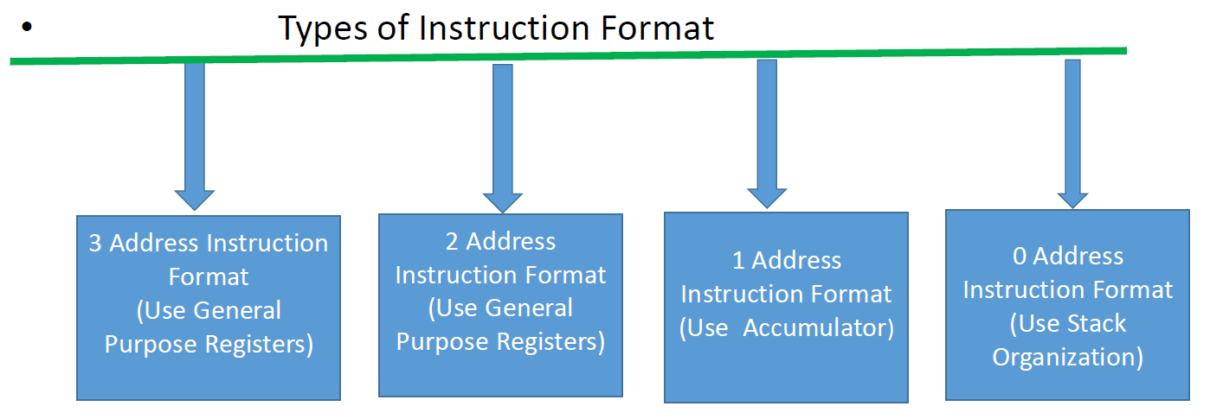
Instruction Format
Notes:
5

Slide 4
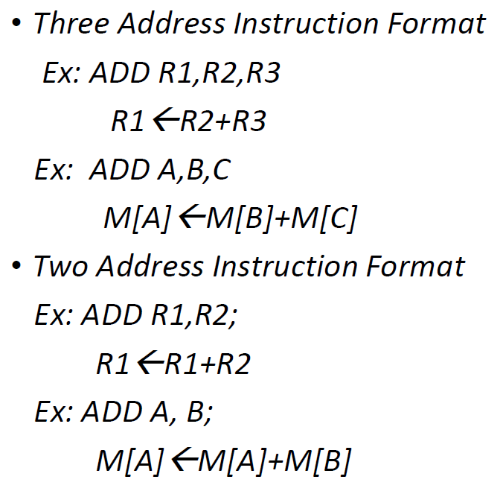
Instruction Format
Notes:
5

Slide 5
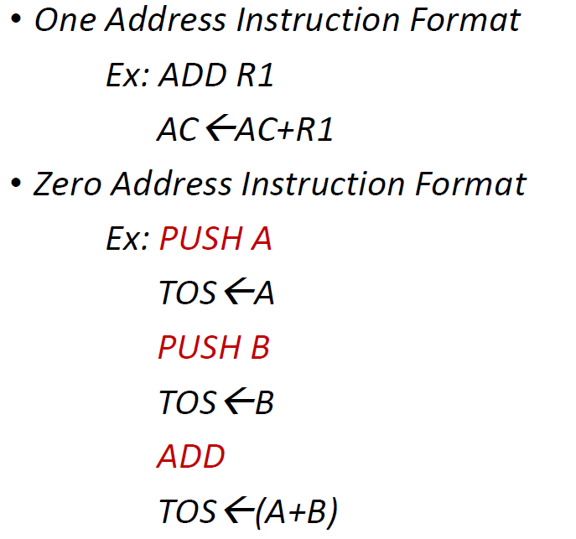
Instruction Format
Notes:
5
TOS= top of stack

Slide 6
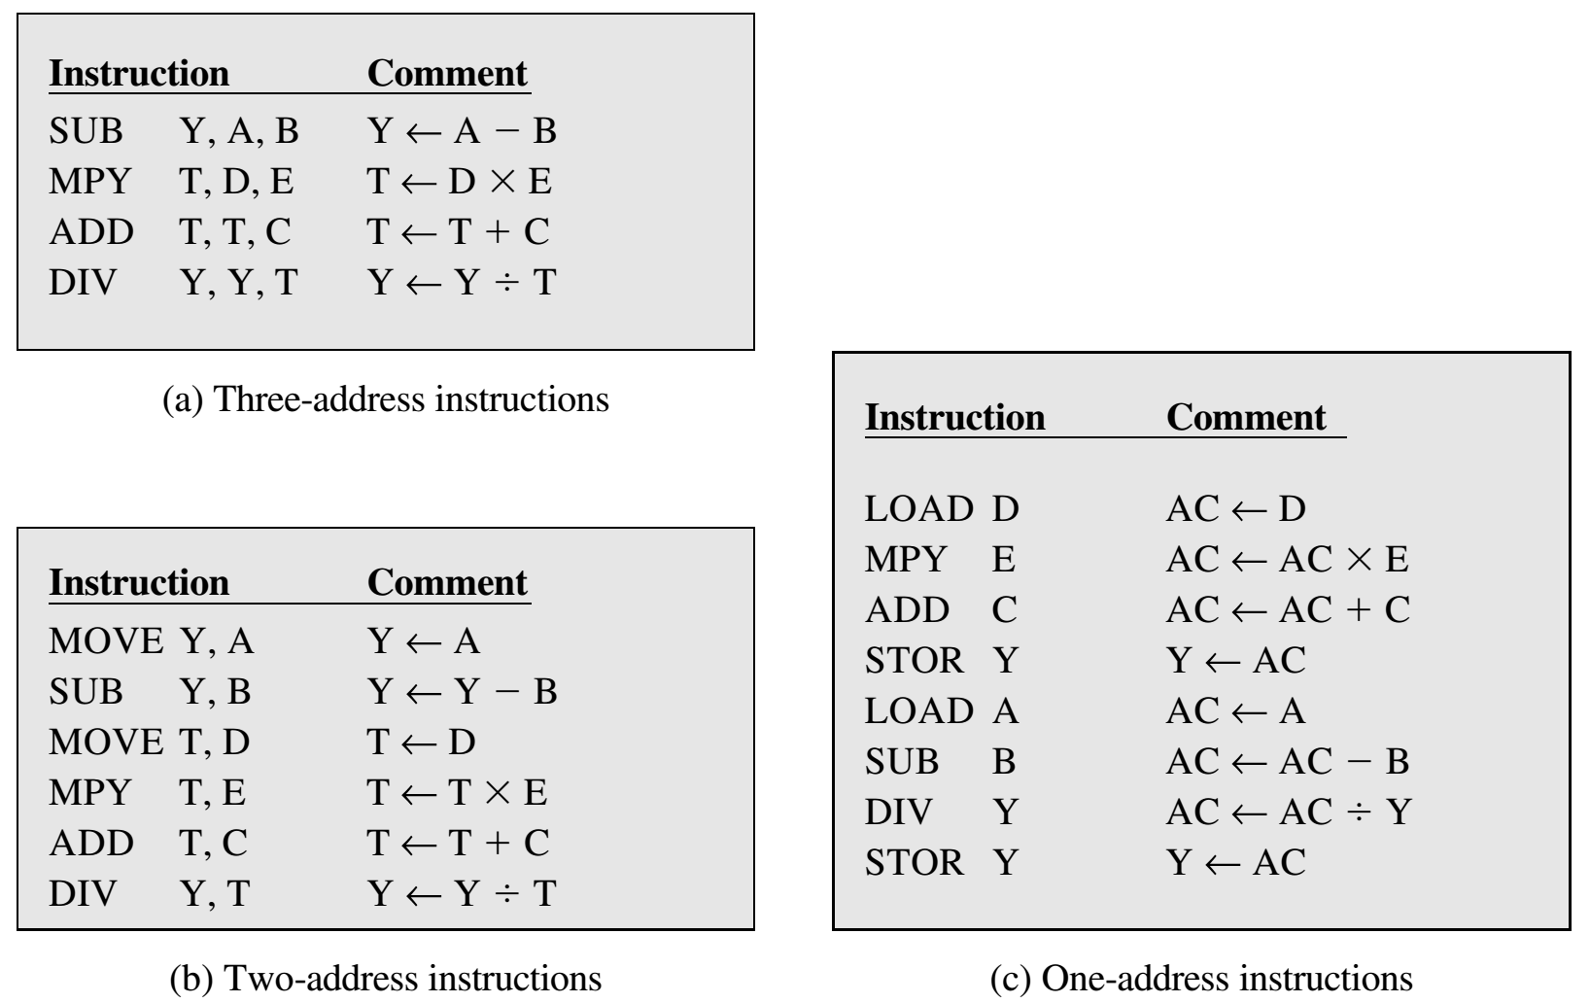


Slide 7
Instruction Set
8086 supports 8 types of instructions.
Data Transfer Instructions
Arithmetic Instructions
Logical/Bit Manipulation Instructions
String Instructions
Program Execution Transfer Instructions
Process Control Instructions
Iteration Control Instructions
Interrupt Instructions

Slide 8
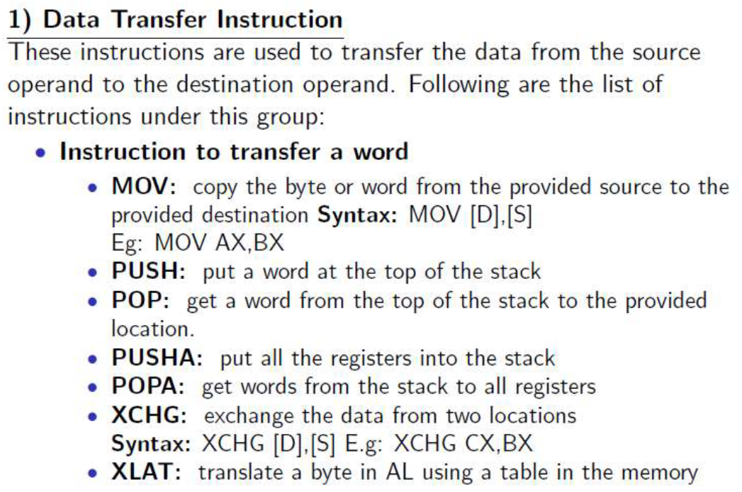
Instruction Set

Slide 9
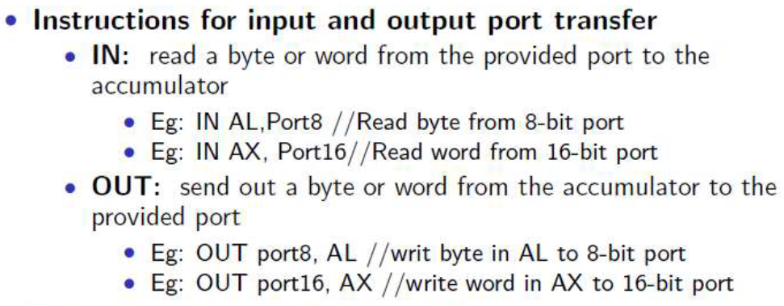
Instruction Set

Slide 10
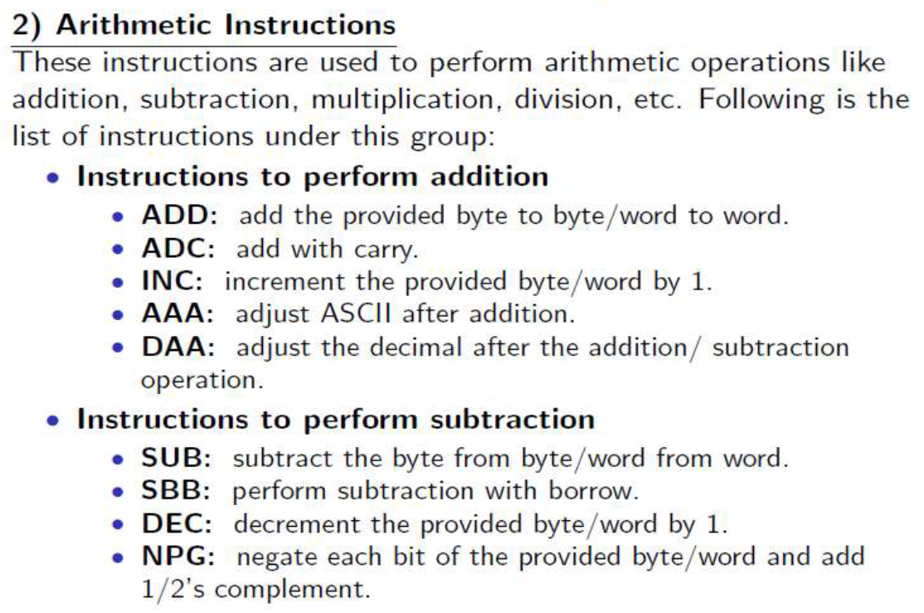
Instruction Set
Notes:
ASCII is used to translate computer text to human text.
All computers speak in binary, a series of 0 and 1. However, just like English and Spanish can use the same alphabet but have completely different words for similar objects, computers also had their own version of languages. ASCII is used as a method to give all computers the same language, allowing them to share documents and files.
ASCII is important because the development gave computers a common language.

Slide 11
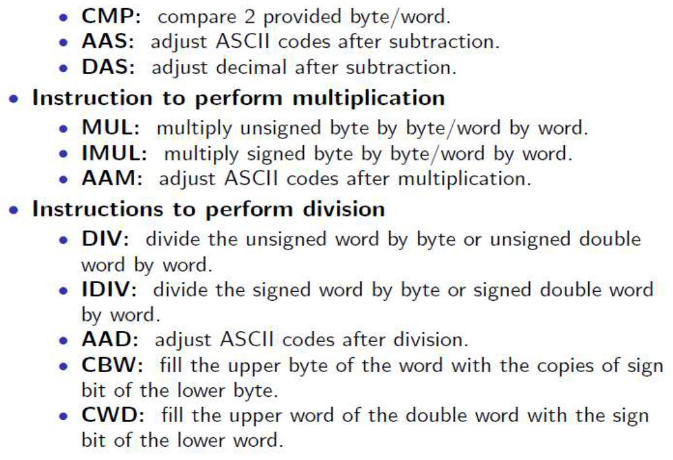
Instruction Set

Slide 12
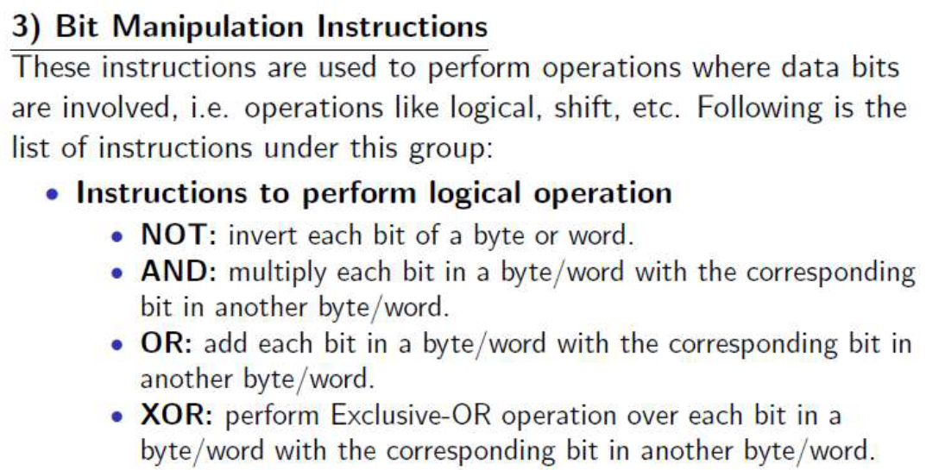
Instruction Set

Slide 13
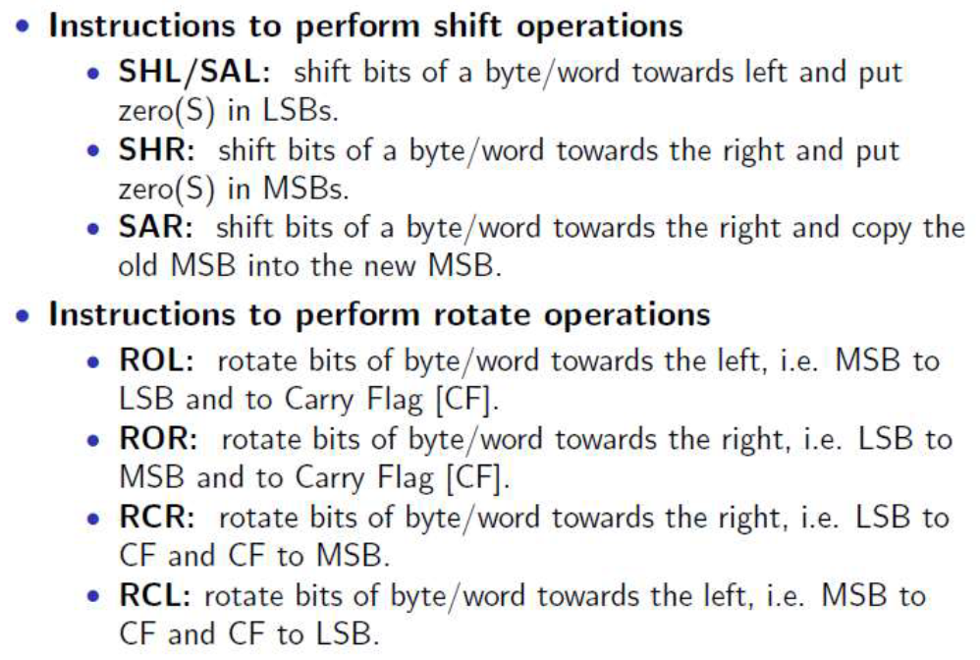
Instruction Set

Slide 14
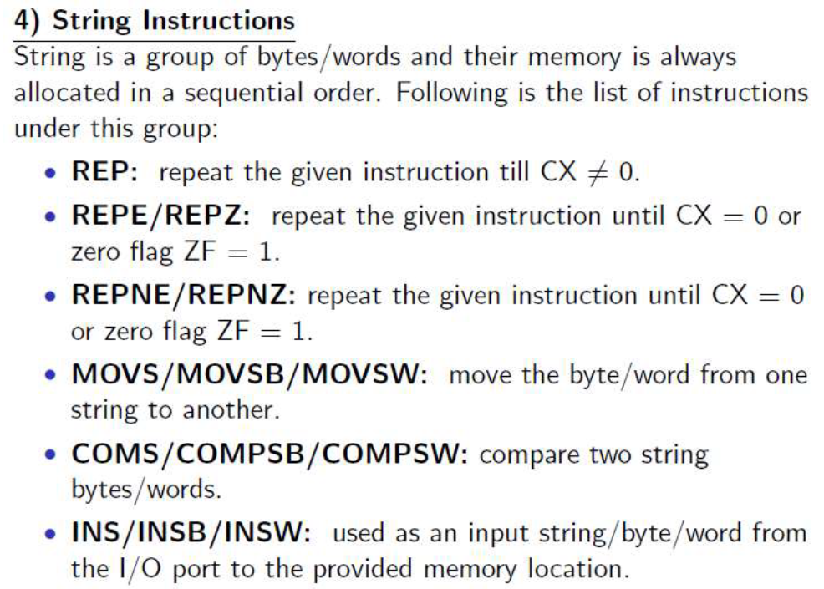

Instruction Set
Notes:
MOVSB= move byte
MOVSW= move word

Slide 15
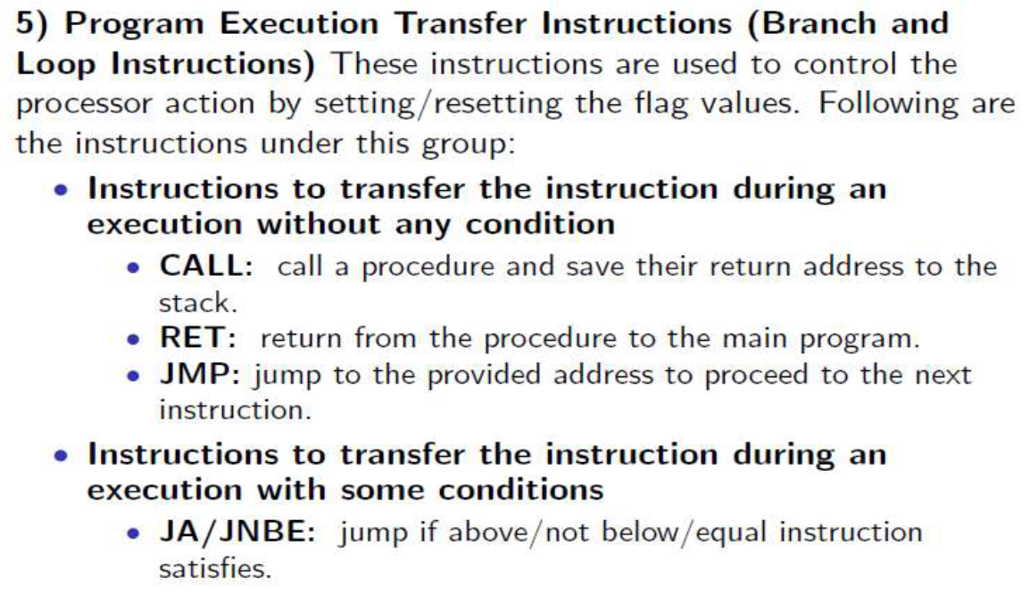
Instruction Set

Slide 16
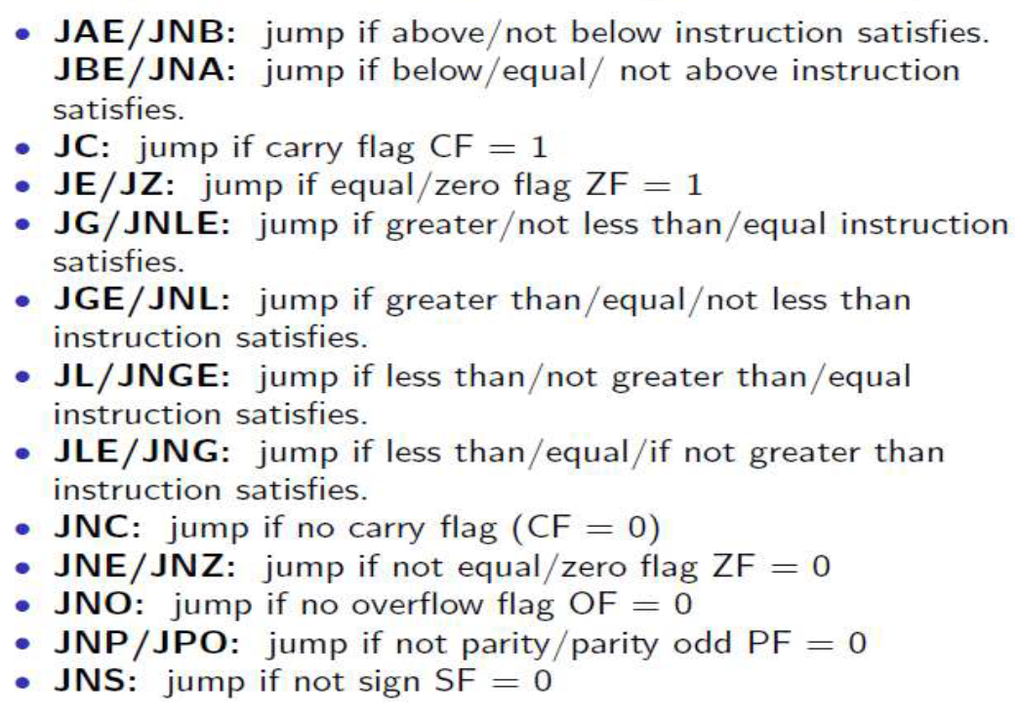
Instruction Set

Slide 17
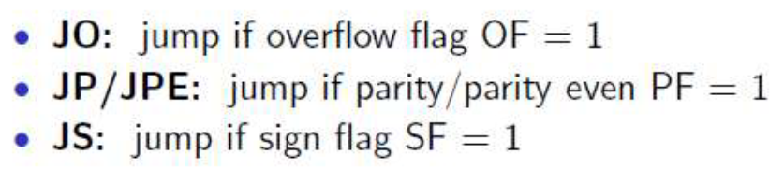
Instruction Set

Slide 18
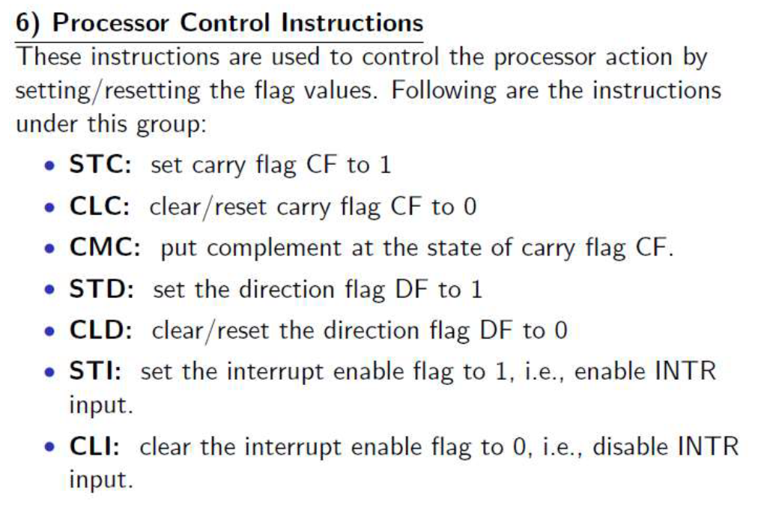
Instruction Set

Slide 19
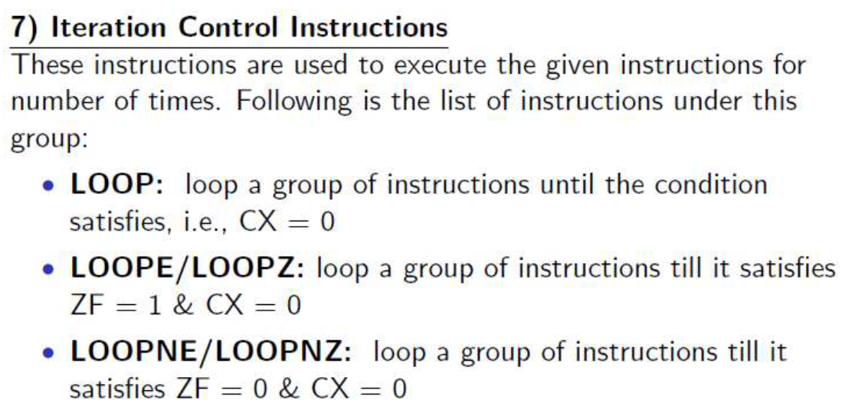
Instruction Set

Slide 20
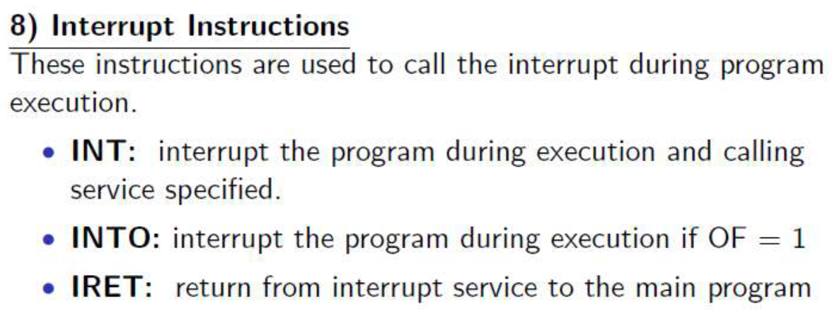
Instruction Set

